Slide 1
Online Software Store Turned Company Site
An over glorified web programming project
Jacob Yankee

Slide 2
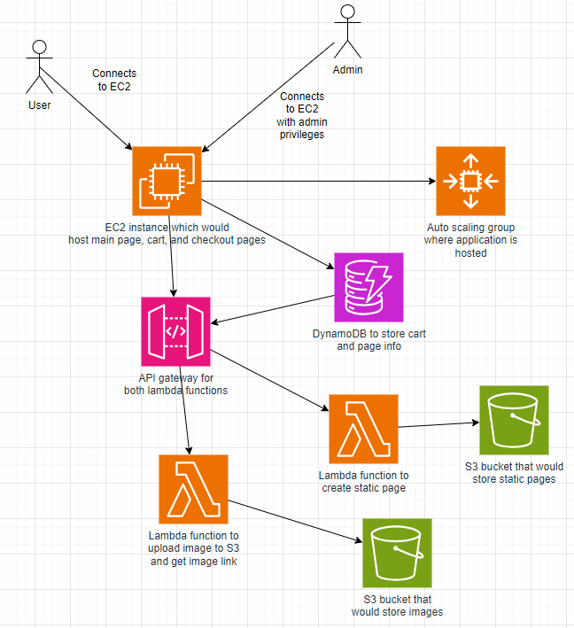
Original Proposed Architecture
The original proposal was for an online
store with this architecture:

Slide 3
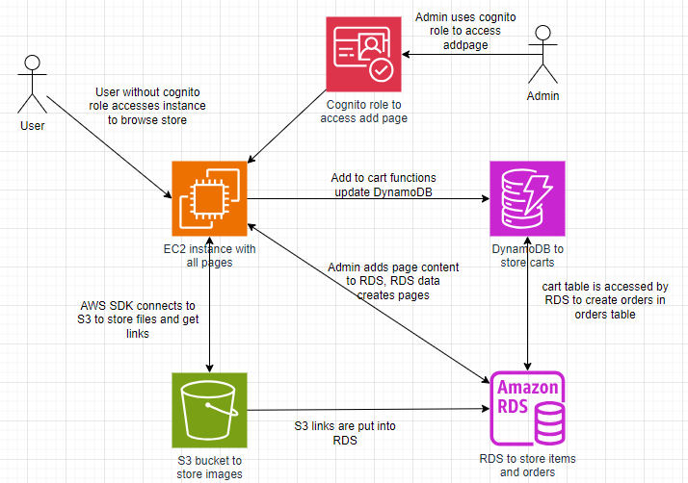
Revised Architecture
After some thinking, I revised
my architecture to this:

Slide 4
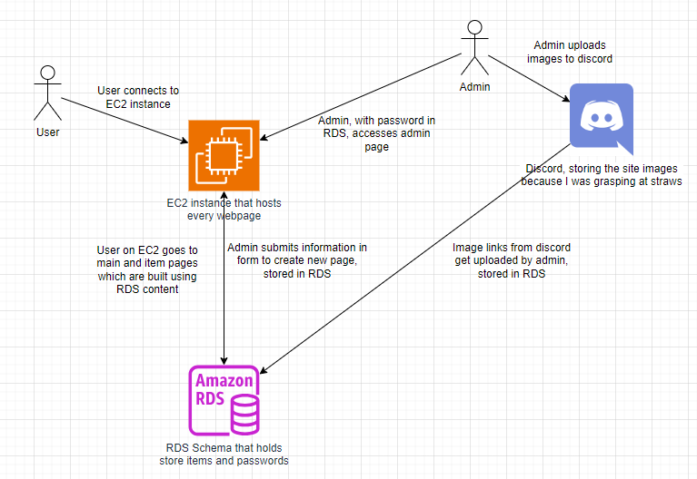
The Actual Architecture
After horribly struggling,
this was the end result…

Slide 5
What went wrong
Overconfidence- AWS labs make the service seem very easy to learn and use (it is not)
Poor time management- This is a given
AWS SDK for PHP- Can somehow connect to S3, RDS, DynamoDB, and more flawlessly. Could not figure it out.

Slide 6

Site in action

